Slide 1
Predicting Cuisine Type from Restaurant Menu Language
Sierra Cockerill

Slide 2
The purpose:
Use NLTK to train a computer to “scan” the language in a menu and guess the cuisine type
Quickly gather data on restaurant ethnicities in an area
Analyze the effectiveness of language choice in menu design

Slide 3
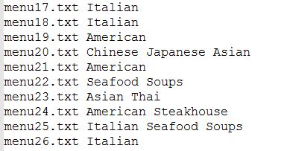
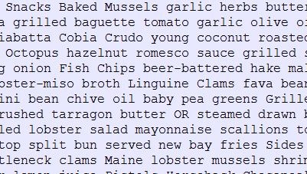
Corpus:
TripAdvisor data
Categorized Corpus Reader
2,200 menu files, 84 cuisines, 14 general categories

Slide 4
Classifier:
Naïve Bayes
Featureset: [(dictionary of all most common words found in each file), cuisine]
Averaging 60% accuracy

Slide 5
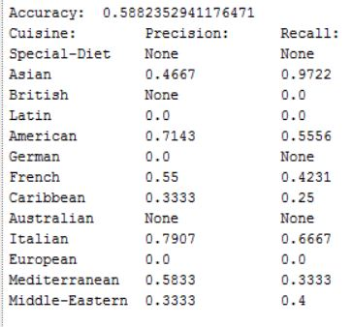
Results:
Using all categories:

Slide 6
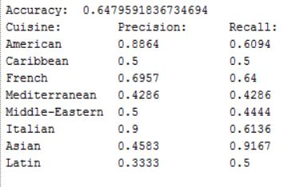
Results:
Using largest categories:

Slide 7
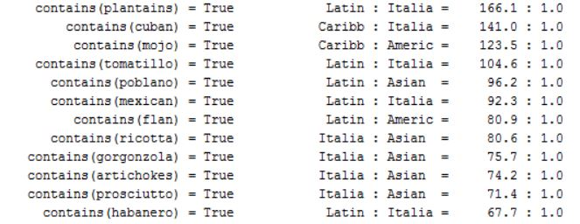
Results:
Most Informative Features:

Slide 8
Could get higher accuracy by:
Making sure that ALL cuisine categories get included in the test set
Pulling data from another city

